Slide 1


Proposal and Investigation of a framework for Cross App Poisoning attacks detection in Software Defined Networks
Edoardo Ottavianelli,
Supervisor Prof. Marco Polverini
A.Y. 22/23
Notes:
‹#›

Slide 2
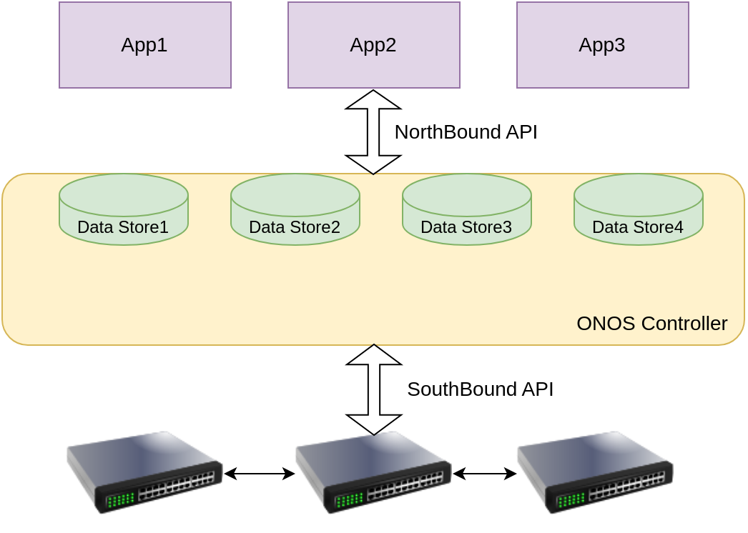
SDN Paradigm (using ONOS)
App-Plane
Pros:
Programmability
Monitoring
Flexibility
Cons:
Security
Complexity
Maintenance
Control-
Plane
Data-Plane
Proposal and Investigation of a framework for Cross App Poisoning attacks detection in Software Defined Networks
‹#›
Notes:
‹#›

Slide 3
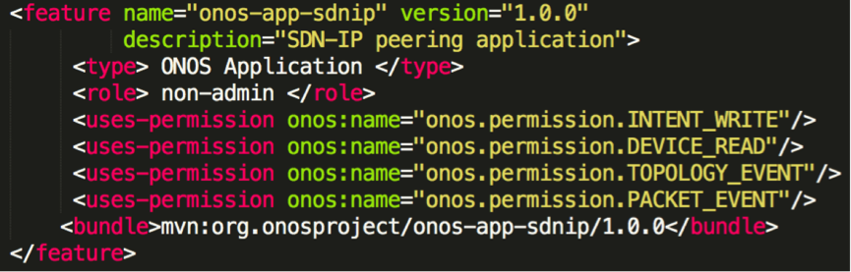
Security-Mode ONOS
Proposal and Investigation of a framework for Cross App Poisoning attacks detection in Software Defined Networks
‹#›
Notes:
‹#›

Slide 4
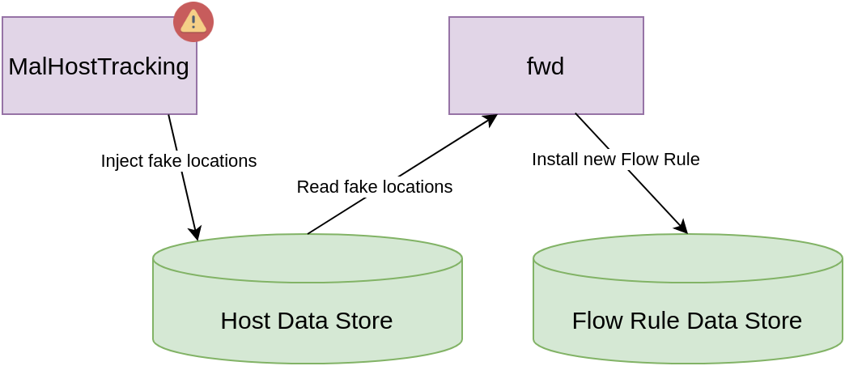
CAP attack in ONOS
MalHostTracking:
HOST_WRITE
fwd:
HOST_READ
FLOW_WRITE
Proposal and Investigation of a framework for Cross App Poisoning attacks detection in Software Defined Networks
‹#›
Notes:
‹#›

Slide 5
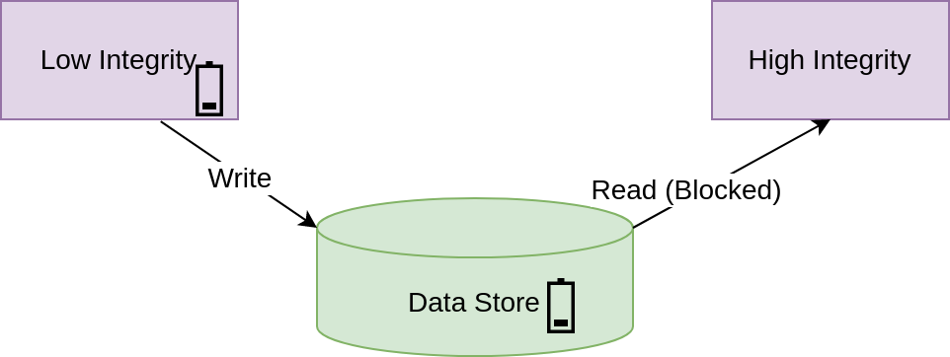
ProvSDN (and vIFC)
Based on Integrity Label Model
Potentially malicious apps deployed in production environment
Hooks on NorthBound API
Based on IFC provenance graph
Proposal and Investigation of a framework for Cross App Poisoning attacks detection in Software Defined Networks
‹#›
Notes:
‹#›

Slide 6
Limitations of existing solutions
The integrity labels model severely limits network capabilities
An attacker could implement a “self-revocation” attack
High Latency due to runtime checks
Proposal and Investigation of a framework for Cross App Poisoning attacks detection in Software Defined Networks
‹#›
Notes:
‹#›

Slide 7
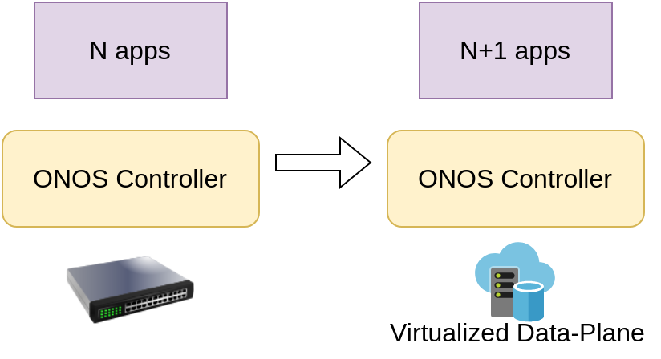
Changing detection approach
Offline detection:
Replicate prod. environment
Extensive logging
Log data mining
Proposal and Investigation of a framework for Cross App Poisoning attacks detection in Software Defined Networks
‹#›
Notes:
‹#›

Slide 8
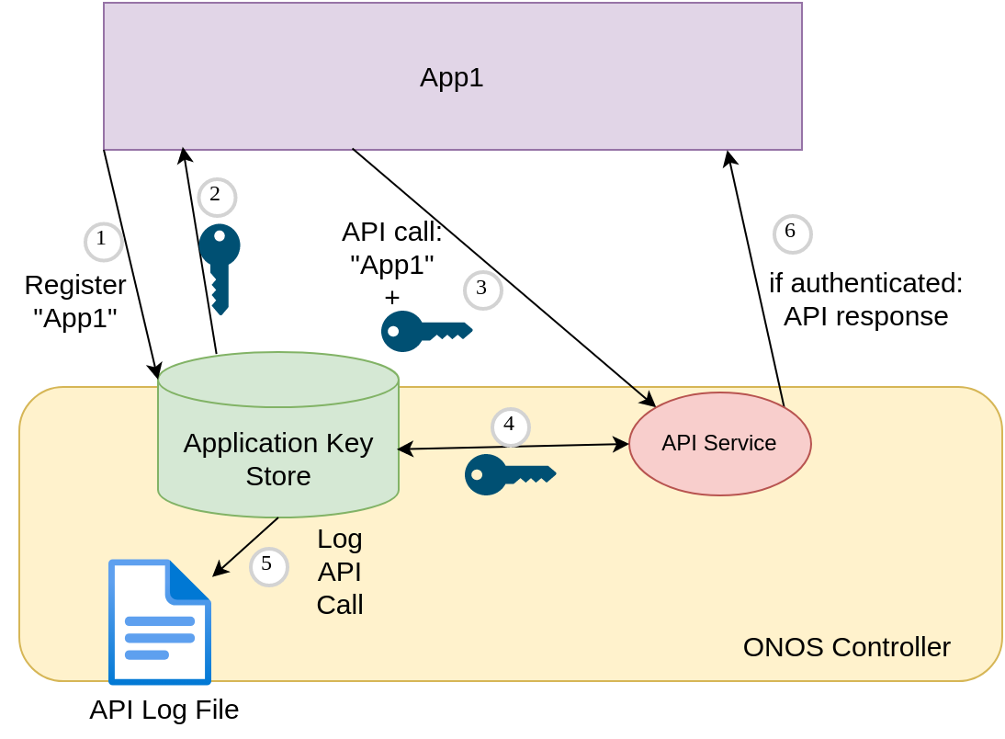
Application key store
Proposal and Investigation of a framework for Cross App Poisoning attacks detection in Software Defined Networks
‹#›
Notes:
‹#›

Slide 9
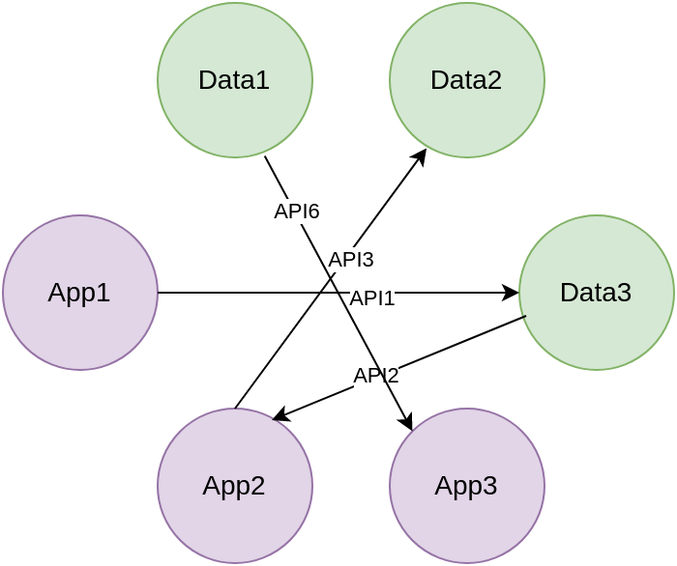
Log mining + graph construction
Timestamp App1 API1 Parameters
Timestamp App2 API6 Parameters
Timestamp App2 API2 Parameters
Timestamp App3 API5 Parameters
Timestamp App2 API3 Parameters
. . .
. . .
Proposal and Investigation of a framework for Cross App Poisoning attacks detection in Software Defined Networks
‹#›
Notes:
‹#›

Slide 10
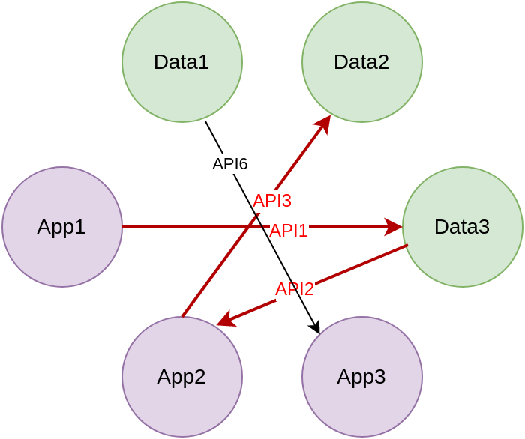
Search for potential CAP attacks
CAP Attack vector set:
Cv(G) = {app0, obj1, app2, obj3, …, appN-1, objN} | N >= 3; N is odd
Search potential CAP attacks using a time section:
Timestamp App1 API1 Parameters
Timestamp App2 API6 Parameters
Timestamp App2 API2 Parameters
Timestamp App3 API5 Parameters
Timestamp App2 API3 Parameters
Timestamp App2 API3 Parameters
. . .
. . .
1s
Proposal and Investigation of a framework for Cross App Poisoning attacks detection in Software Defined Networks
‹#›
Notes:
‹#›

Slide 11
Tests and results 1
Exploited 240 CAP attacks
Virtualized 4 hosts and 4 switches using Mininet
No one of the hosts can receive packets
Proposal and Investigation of a framework for Cross App Poisoning attacks detection in Software Defined Networks
‹#›
Notes:
‹#›

Slide 12
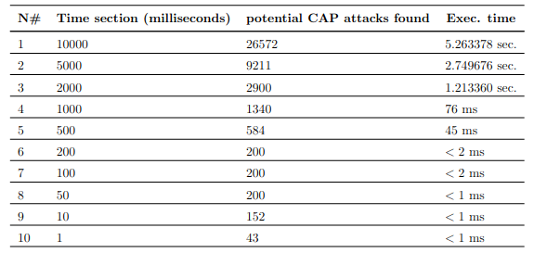
Tests and results 2
Less than 1ms of overhead
Secure defense mechanism
Complete control over the test environment
Network capabilities not limited
Proposal and Investigation of a framework for Cross App Poisoning attacks detection in Software Defined Networks
‹#›
Notes:
‹#›

Slide 13
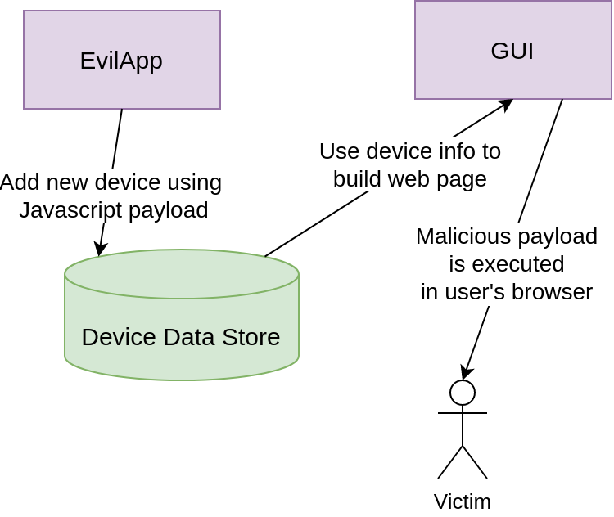
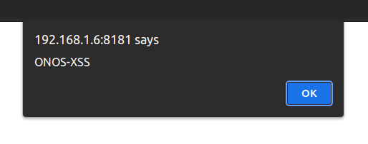
CAP Attack targeting Web app
HttpOnly flag set 😭
Keylogger 😈
Phishing 😈
Proposal and Investigation of a framework for Cross App Poisoning attacks detection in Software Defined Networks
‹#›
Notes:
‹#›

Slide 14
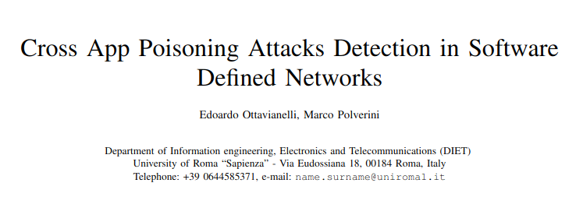
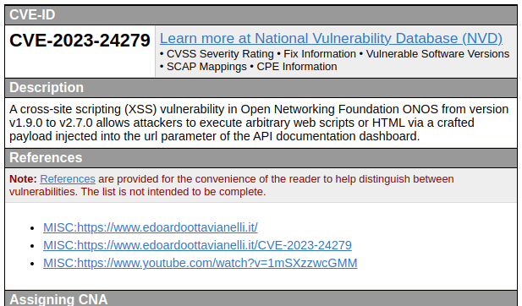
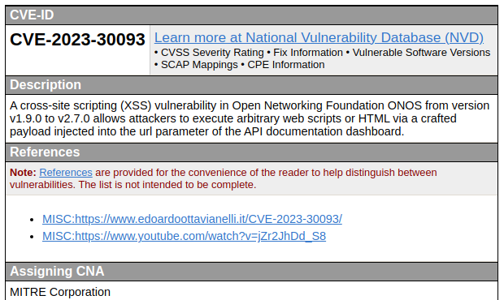

Paper + CVEs
Proposal and Investigation of a framework for Cross App Poisoning attacks detection in Software Defined Networks
‹#›
Notes:
‹#›

Slide 15
Future work
Add auth support for all ONOS API
Improve Log data mining
Continue vulnerability research
Proposal and Investigation of a framework for Cross App Poisoning attacks detection in Software Defined Networks
‹#›
Notes:
‹#›

